Slide 1



Operations
Analysis Project

Slide 2

MEET OUR TEAM
Dina Elhousiny
Mona Abo Zaid
Wesam Seyam
Ahmed Hamed
Ahmed Abdelfatah

Slide 3

Introduction
This dashboard provides an overview of the company's food product operations.
Offering insights into:
sales trends, top-selling products, and the geographic distribution of suppliers by country, along with their contribution to total revenue.
Additionally, it includes employee performance metrics to assess operational effectiveness.
The dashboard enables quick benchmarking and supports data-driven decisions, ultimately helping to optimize operational efficiency and enhance employee performance levels.

Slide 4

Insights summary
01.
Beverages lead in total sales with fewer units sold, likely due to a higher price per unit, while Dairy Products dominate in quantity sold but generate slightly lower revenue. Grains and Produce perform poorly in both sales and quantity, indicating underperformance in these categories.
02.
Sales Distribution: The majority of sales come from North America, followed by South America and Europe, suggesting that North America is your largest customer base and market.
03.
Order Disruption: The analysis indicates that the period from March to June experienced a significant disruption, likely due to a system failure or operational issues, which impacted sales and customer relationships. However, starting in July, There was a notable recovery in order volume, peaking in December. This gradual increase post-recovery suggests that the company successfully restored operations and regained customer trust.
04.
Top Products & Suppliers: The most expensive product is from France (Côte de Blaye), while Pavlova, Ltd. and Plutzer Lebensmittelgroßmärkte AG supply the most products, indicating a broader product range.

Slide 5

05.
Shipper Performance: Federal Shipping handles the most orders (37.76%), followed by Speedy Express and United Package.
06.
Performance of Employees: Margaret: Top performer in both the number of orders and total sales, indicating strong customer engagement and sales effectiveness. Anne: Lowest in both total sales and number of orders, indicating significant room for improvement in her sales approach.

Slide 6

Methodology used in the analysis
Dataset Overview: Orders, Customers, Products, Suppliers, shippers, Employees.
Used: SQL, Python for cleaning & answering data questions and Power BI for visualization.

Slide 7


SQL STEPS
01.
GET DATE & RESTORING OF DATA BASE
02.
03.
Exploring & CHECKING OF CLEANING OF THE DATA
DIGRAM VIEW
ANSWERING THE QUESTIONS

Slide 8
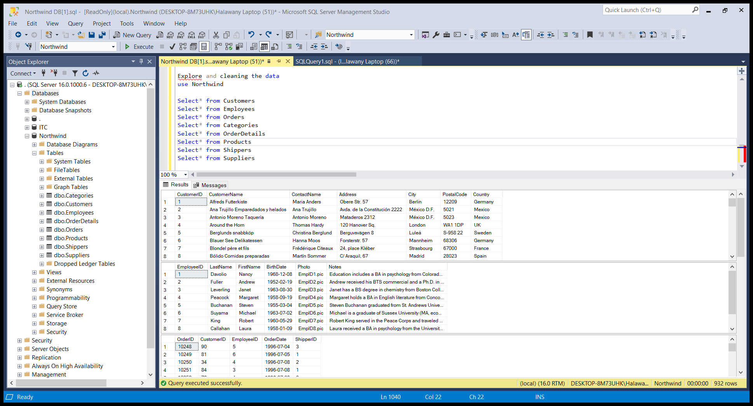
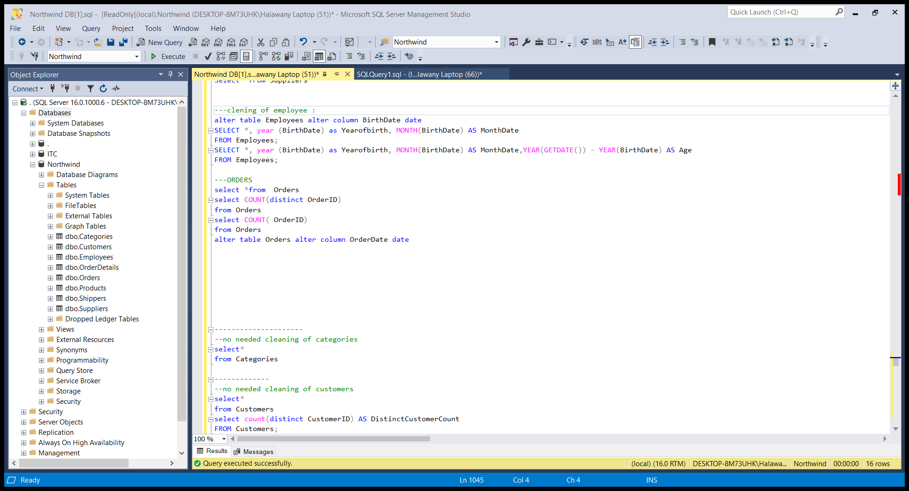
Exploring & CHECKING OF CLEANING OF THE DATA

Slide 9
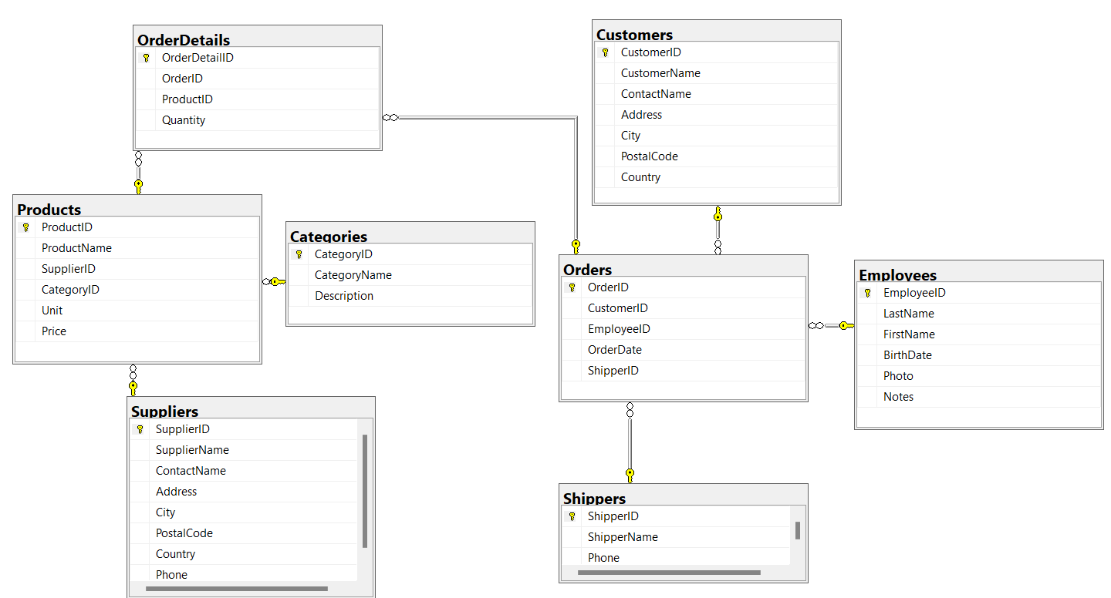
Northwind Diagram

Slide 10
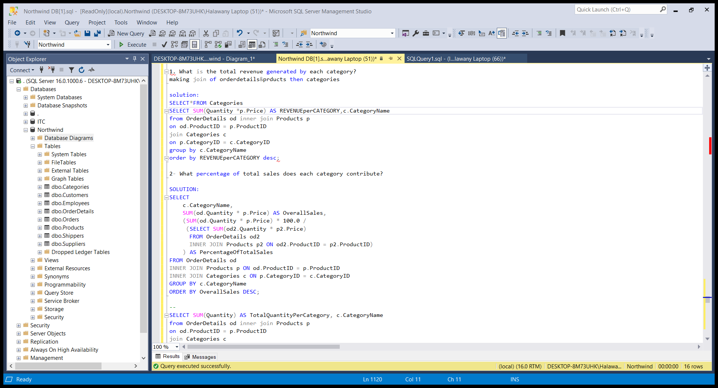
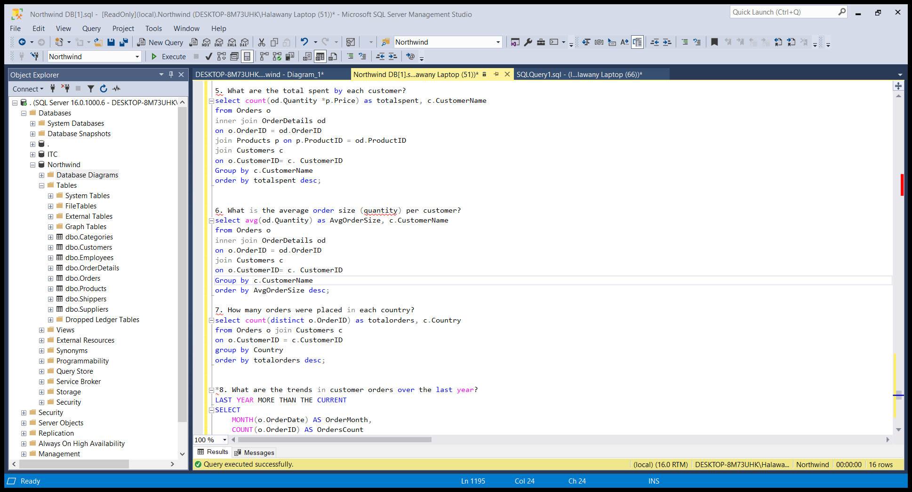
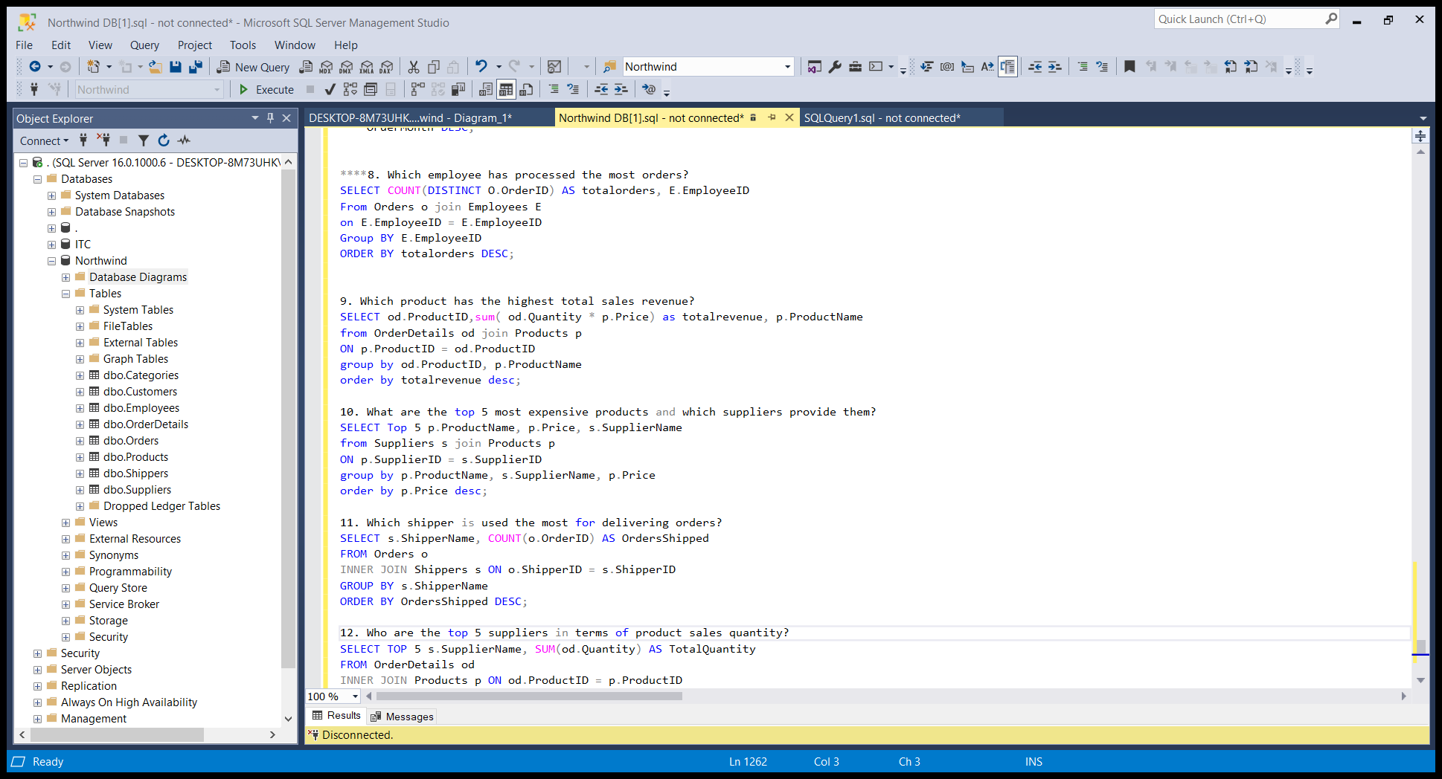
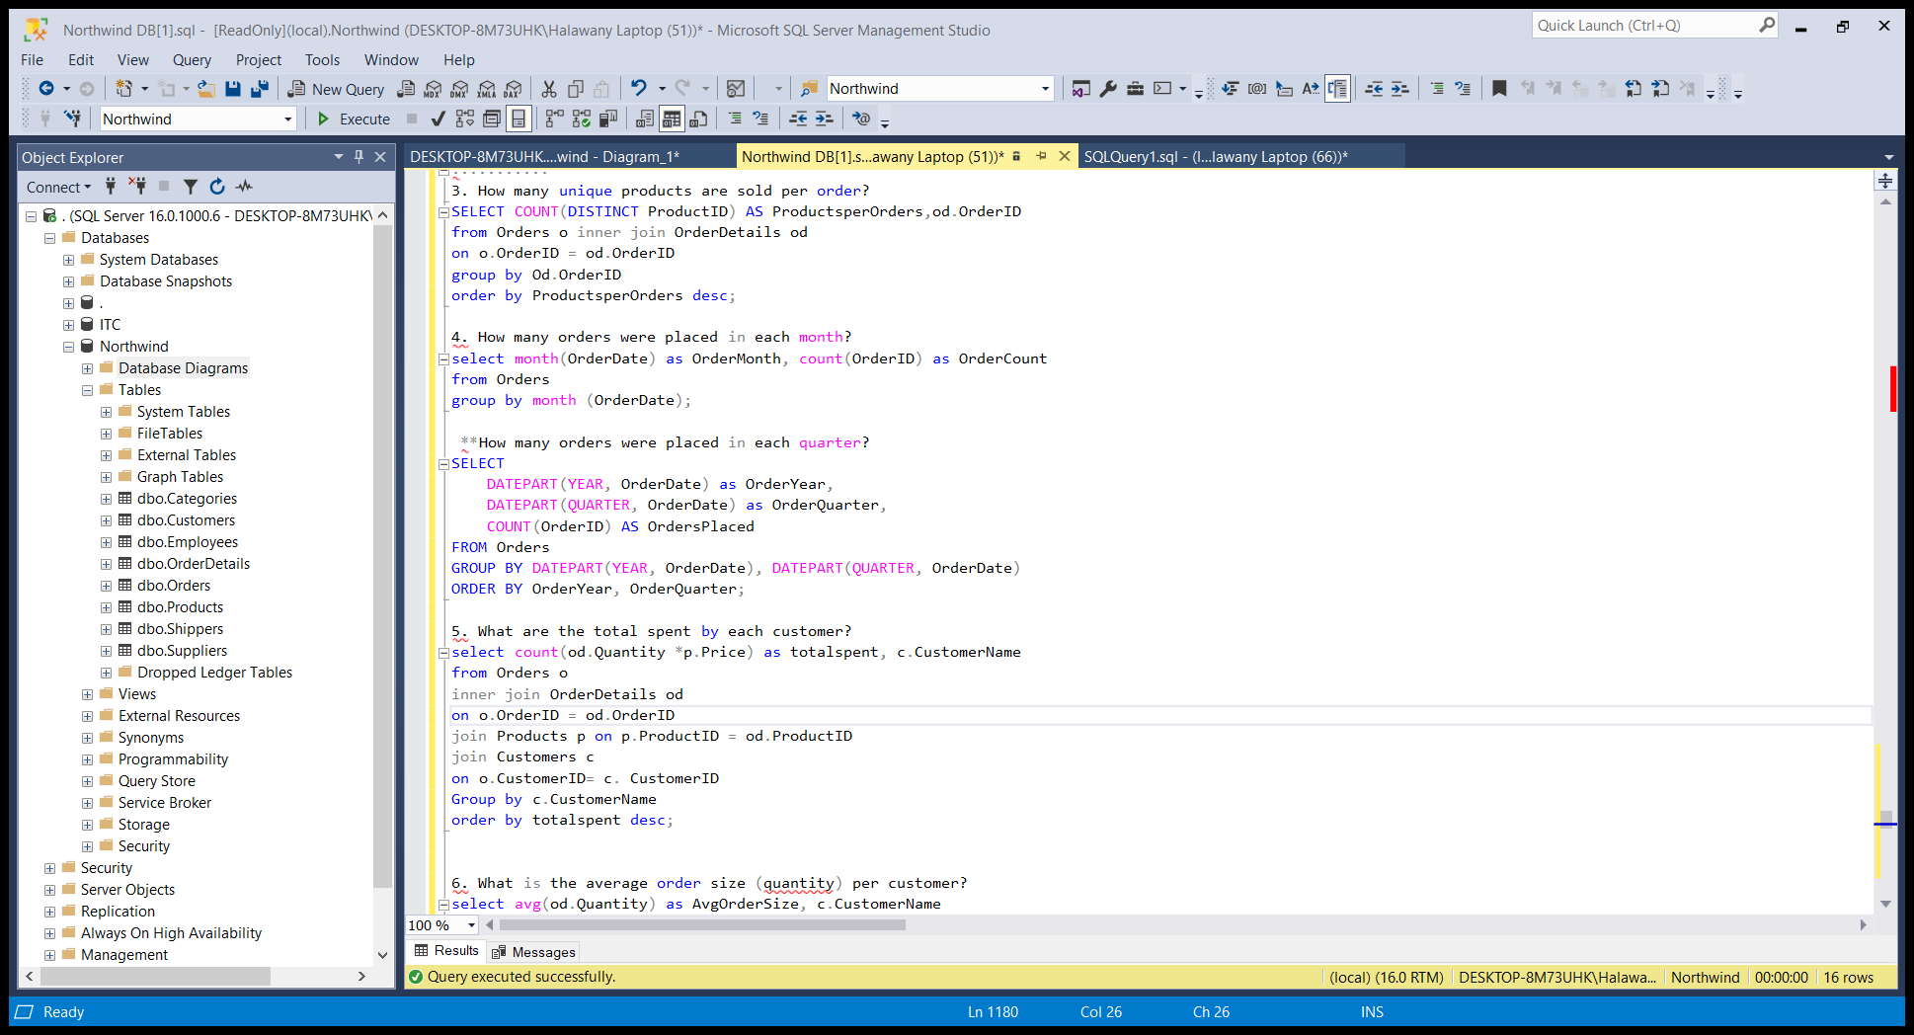
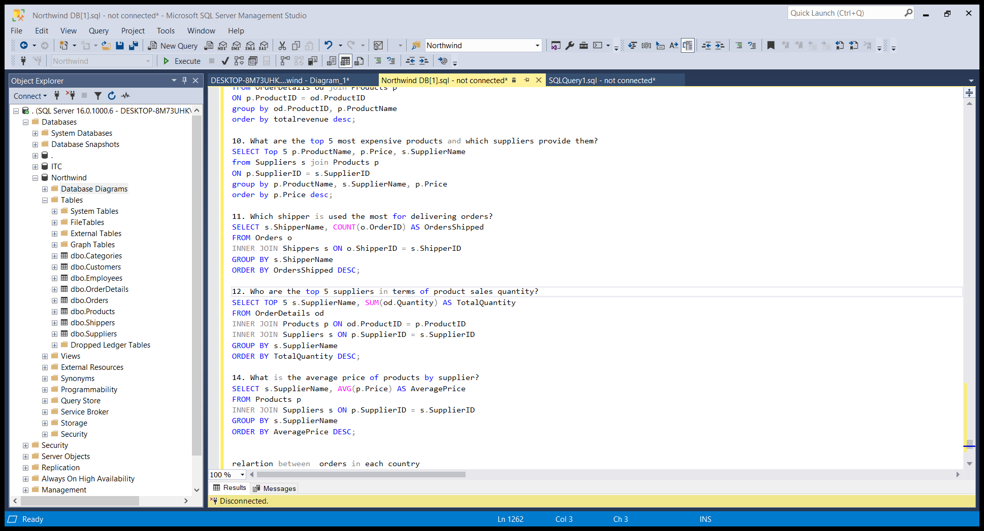
ANSWERING THE QUESTIONS USING SQL

Slide 11
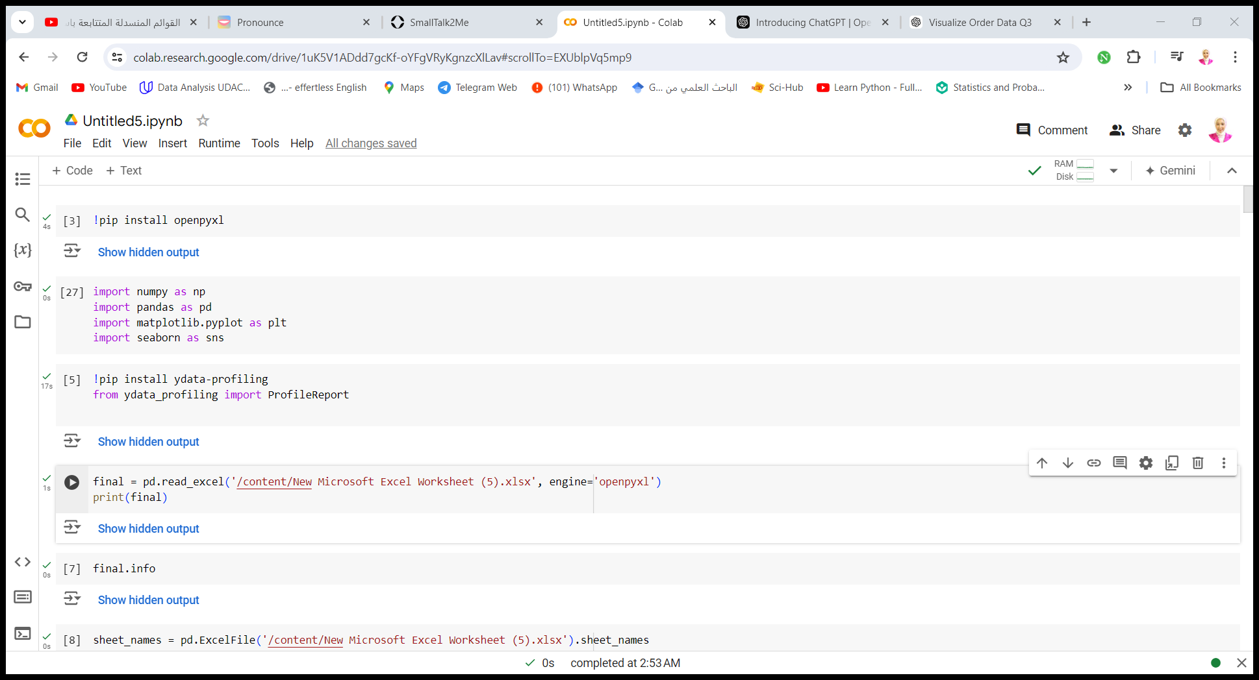
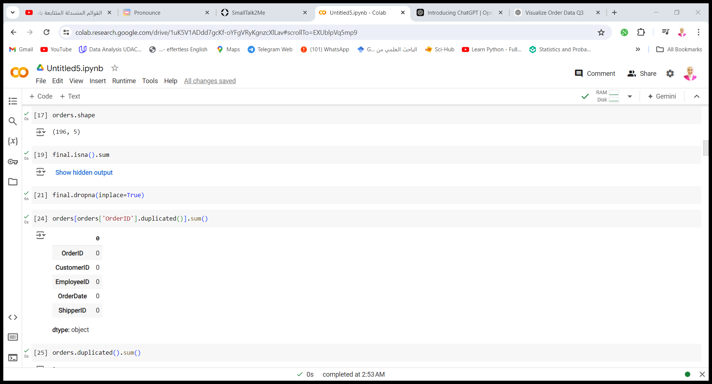
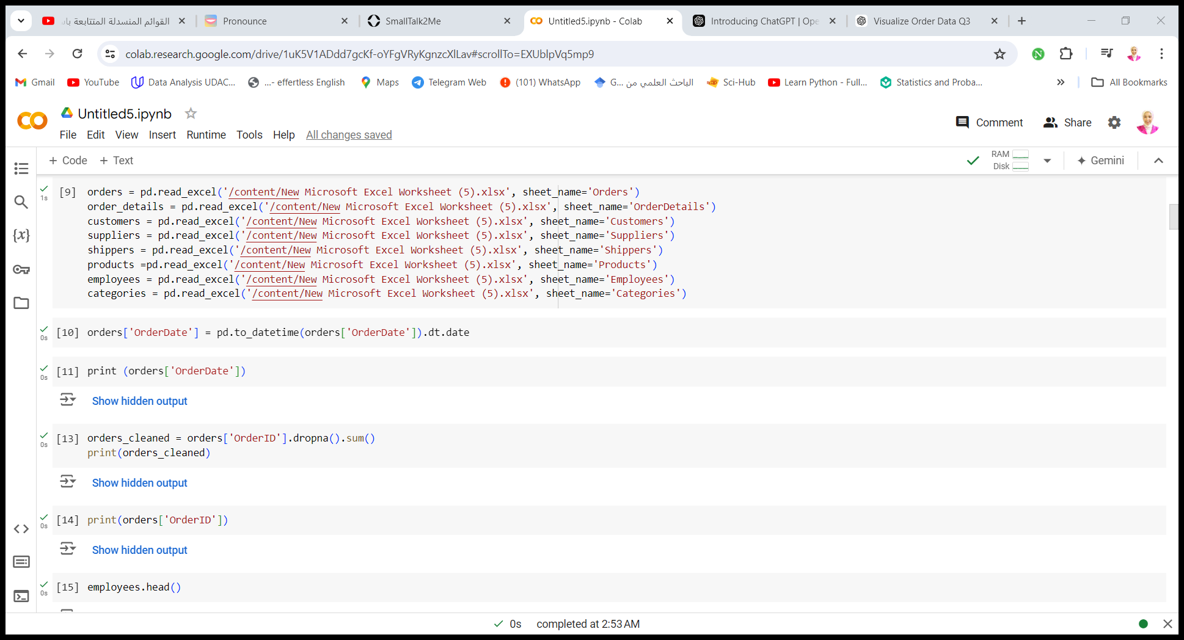
Python Step
Checking the cleaning of the data

Slide 12
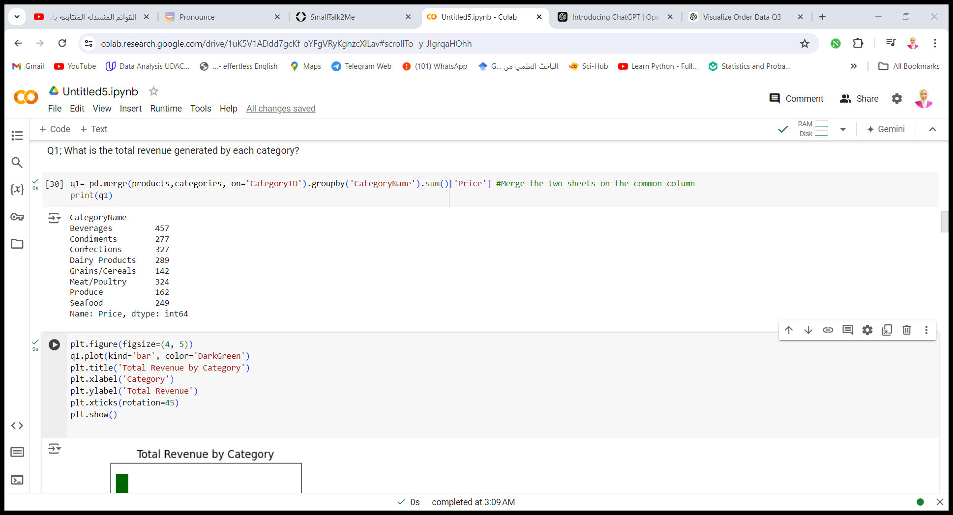
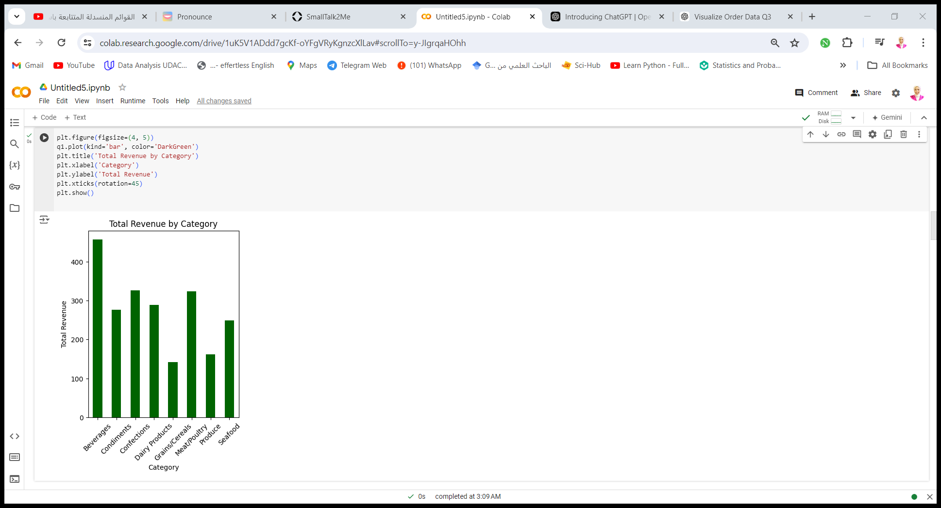
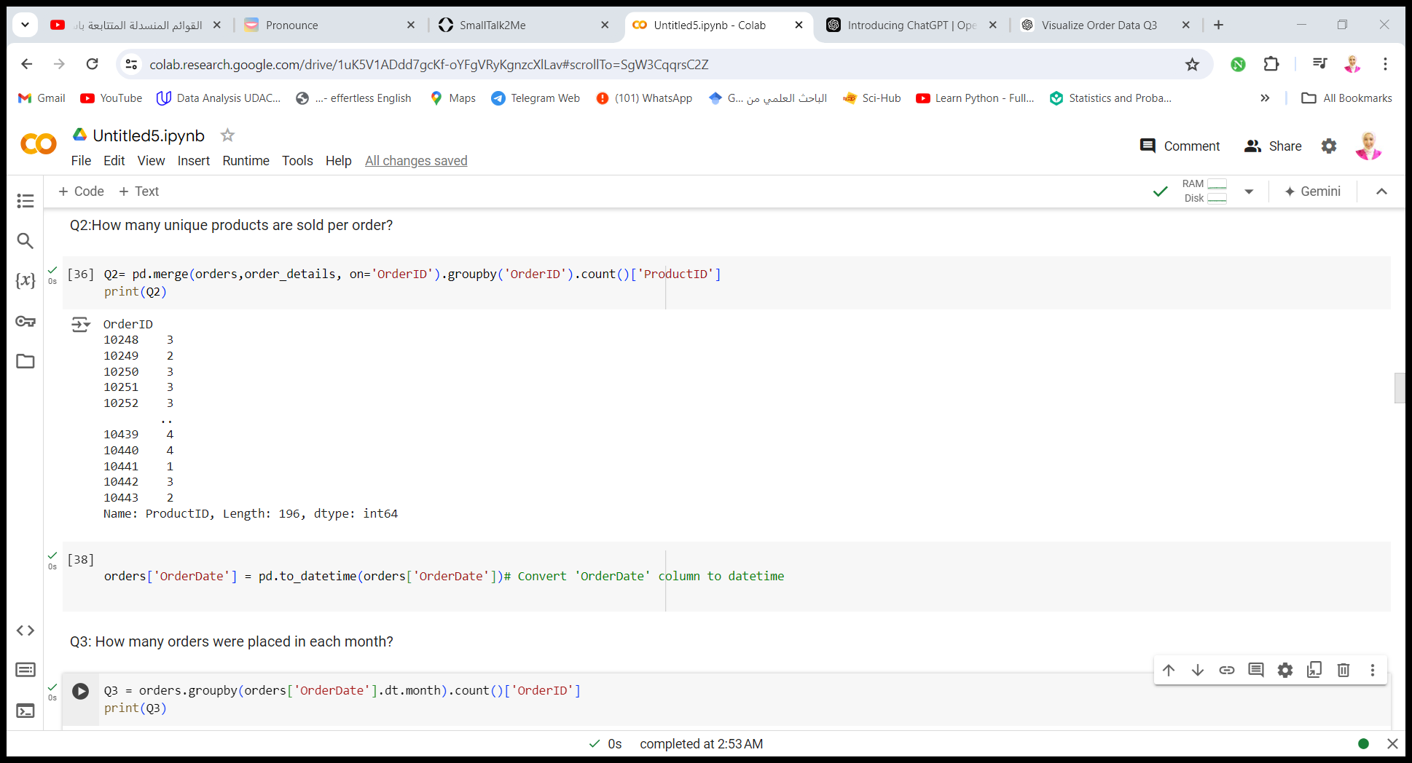
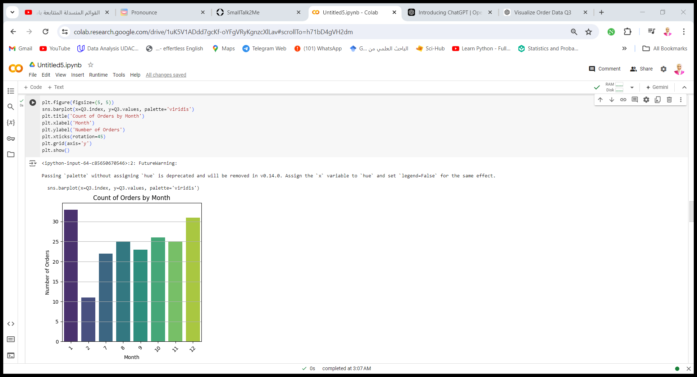
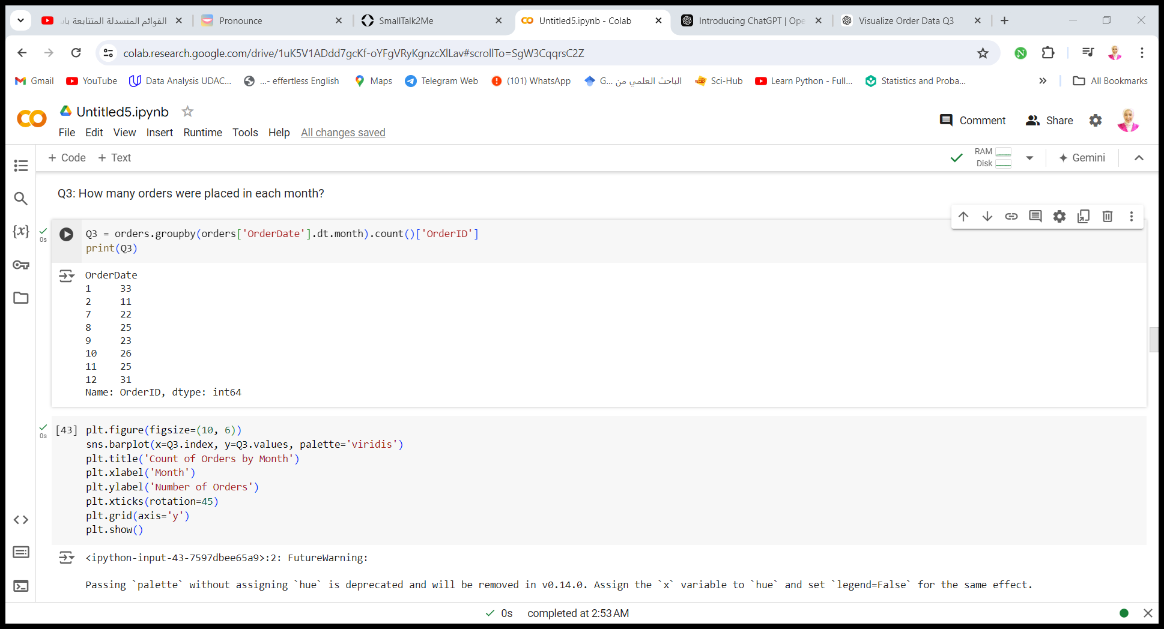
Python Step
Answering Questions with Visualization

Slide 13
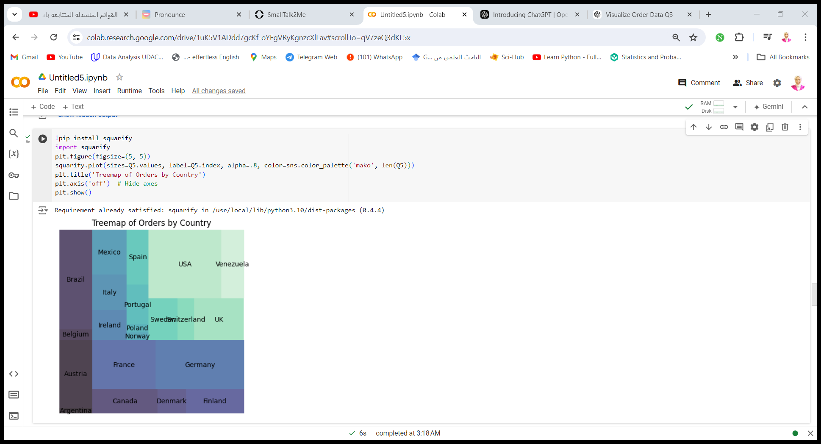
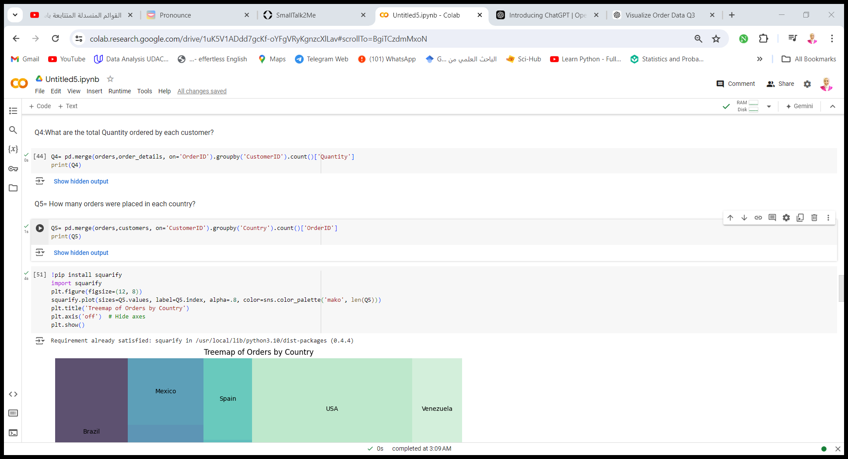
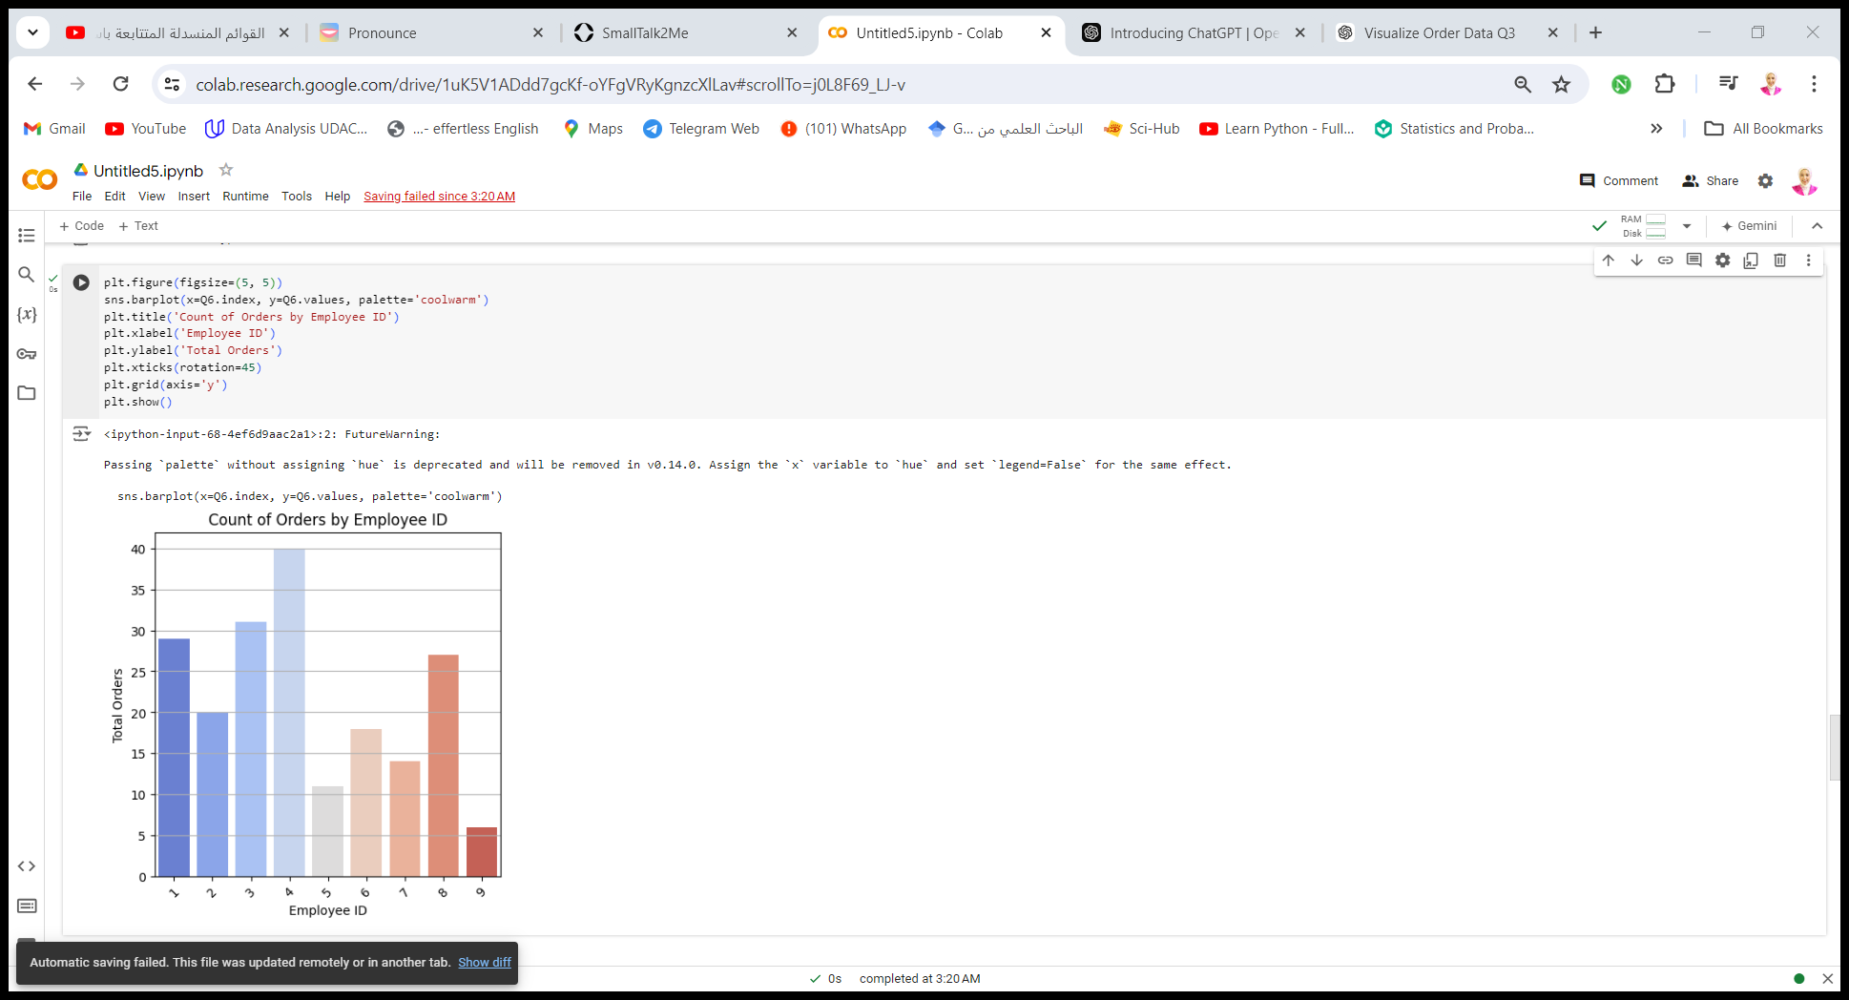
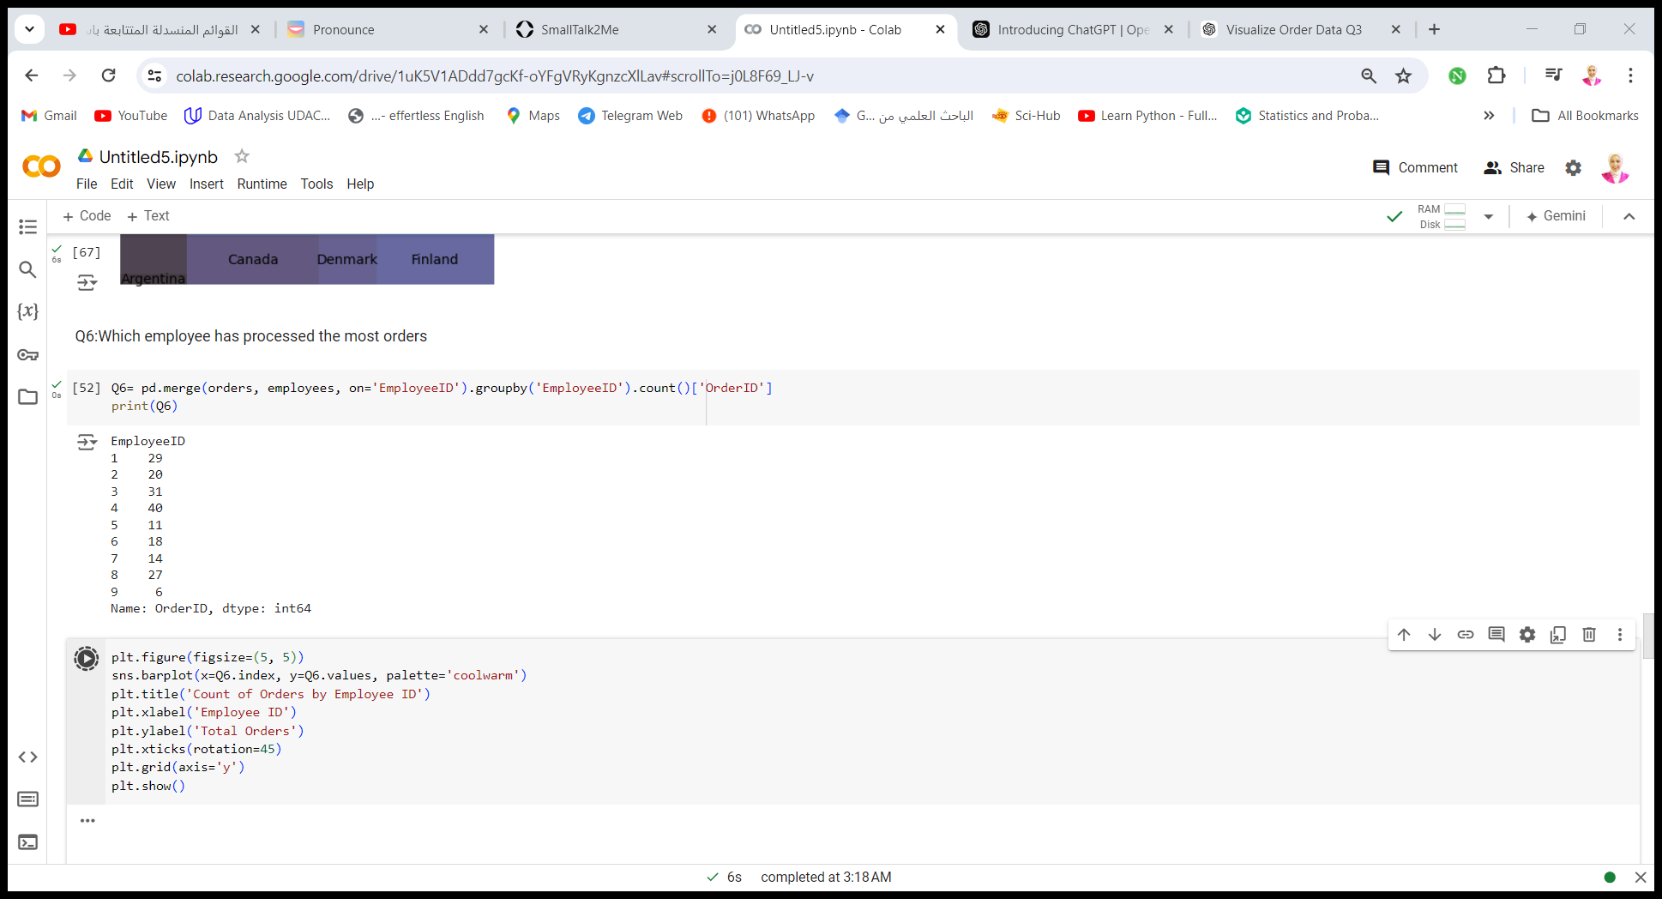
Python Step
Answering Questions with Visualization

Slide 14
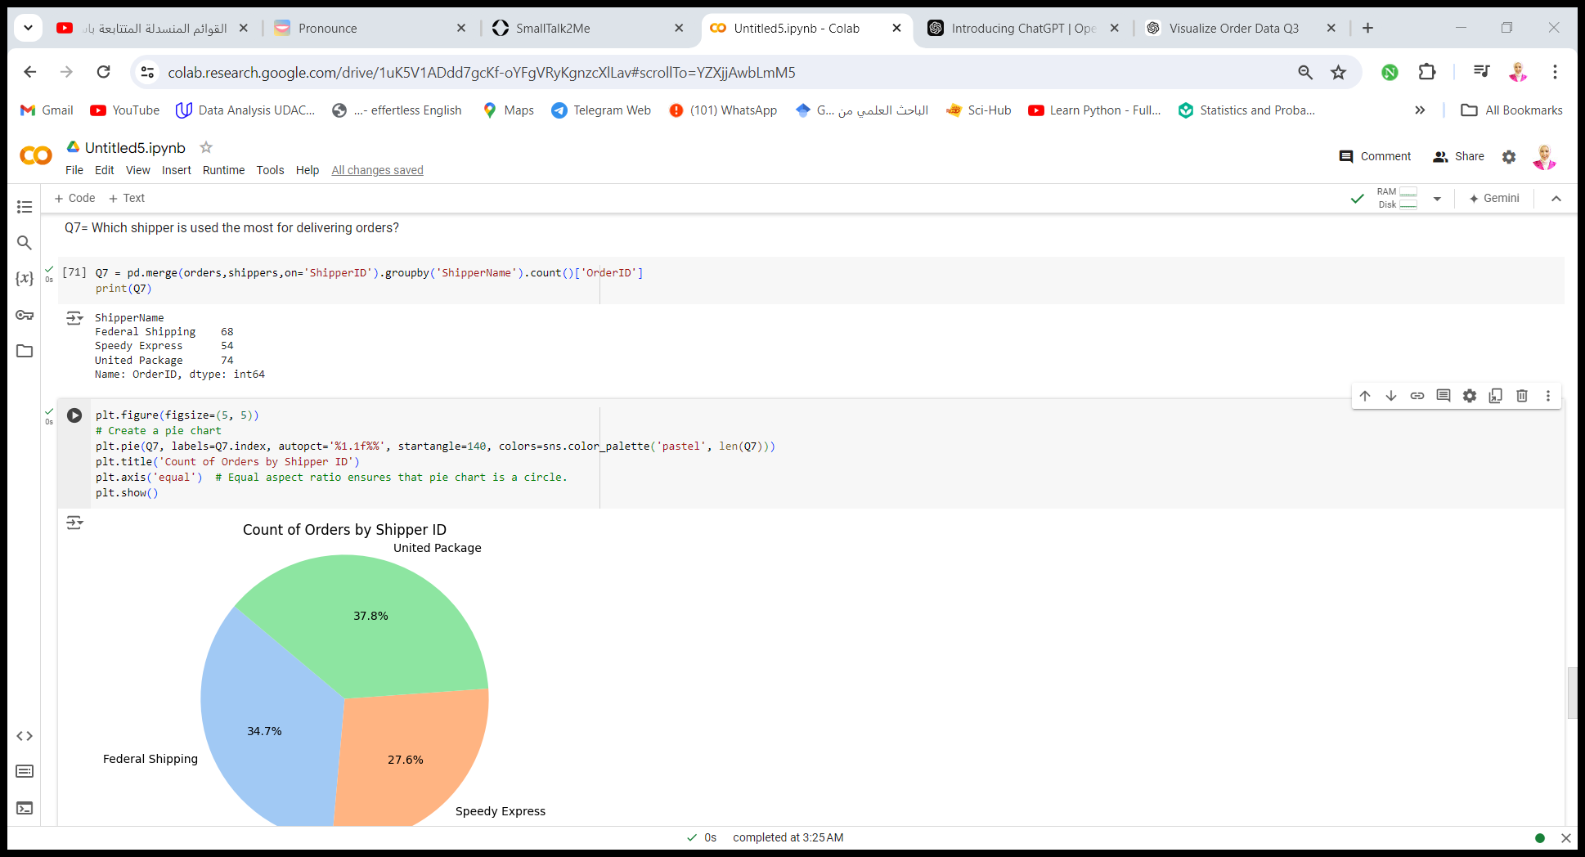
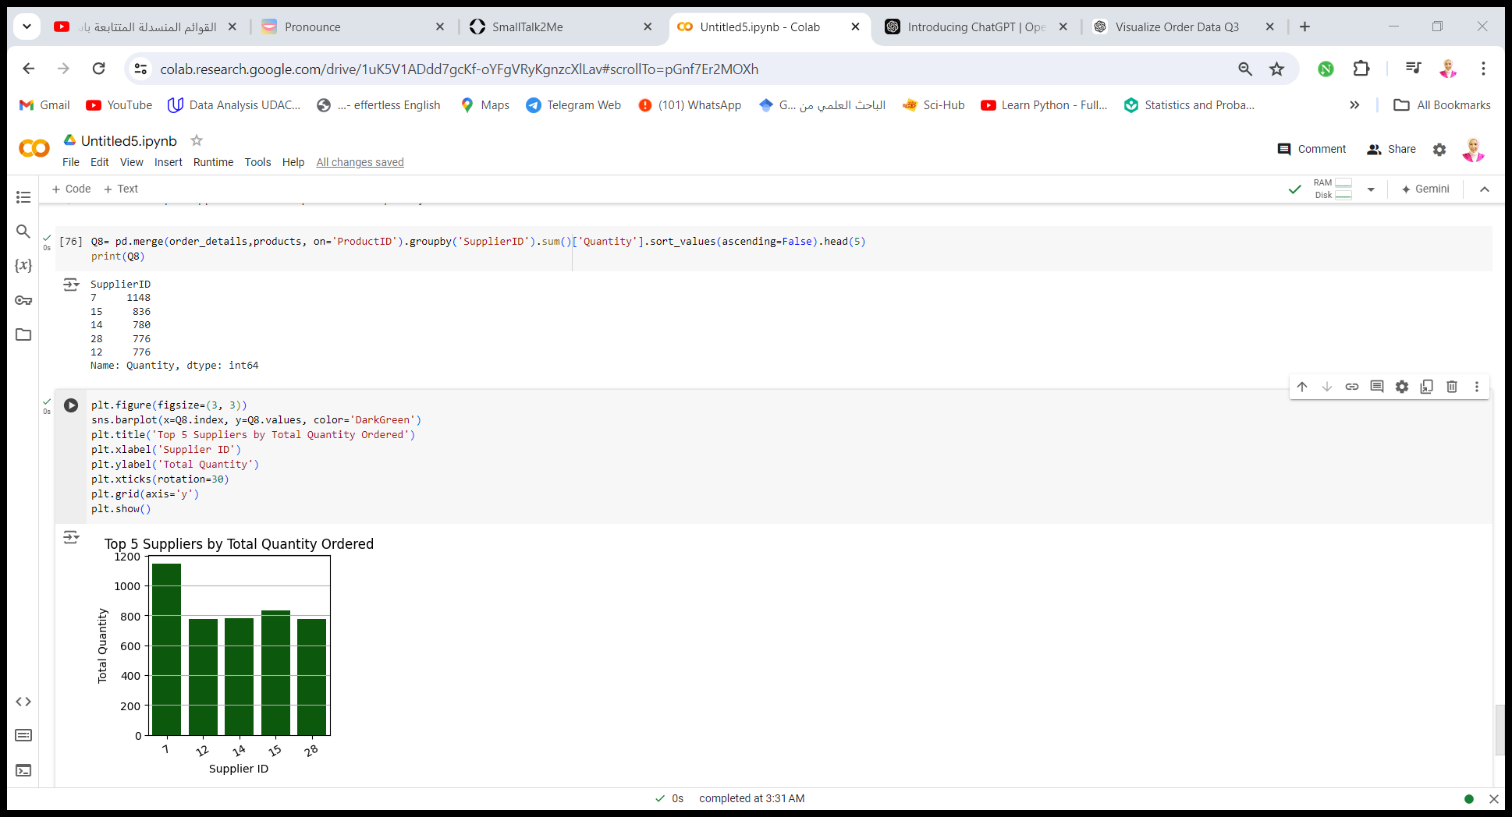
Python Step
Answering Questions with Visualization

Slide 15
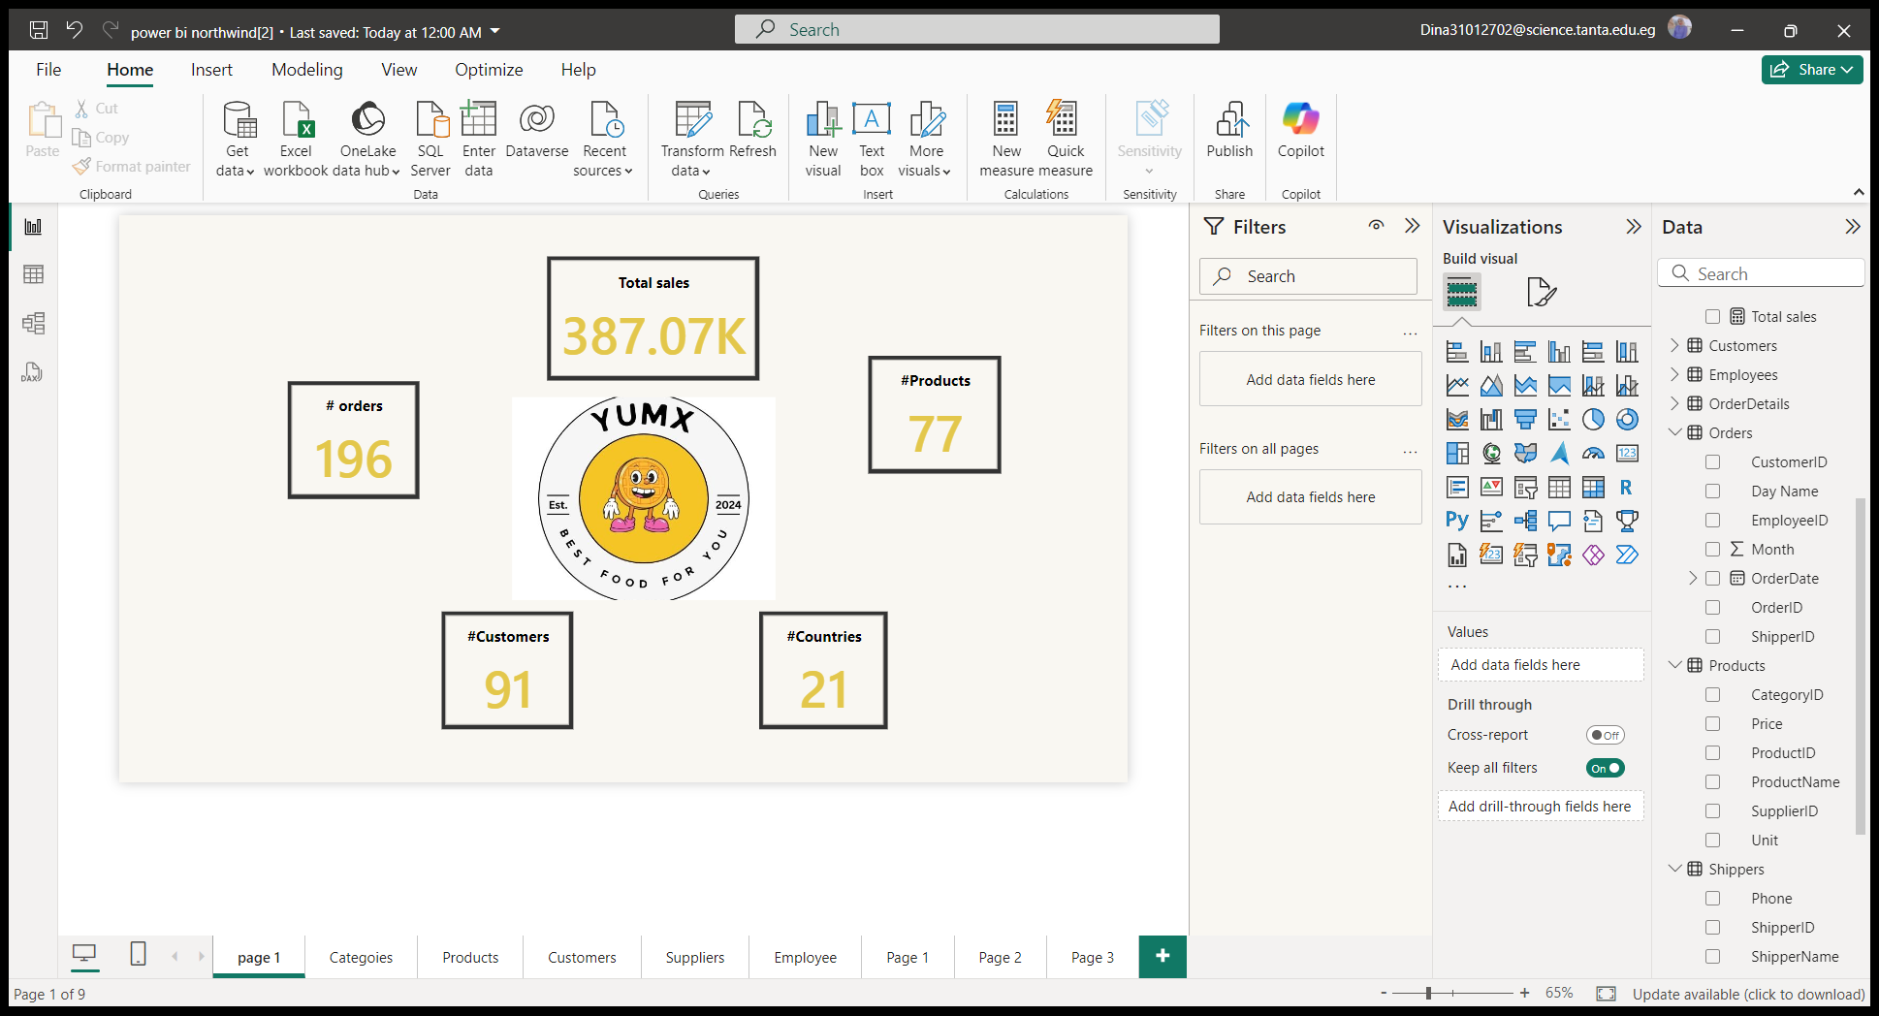

Slide 16
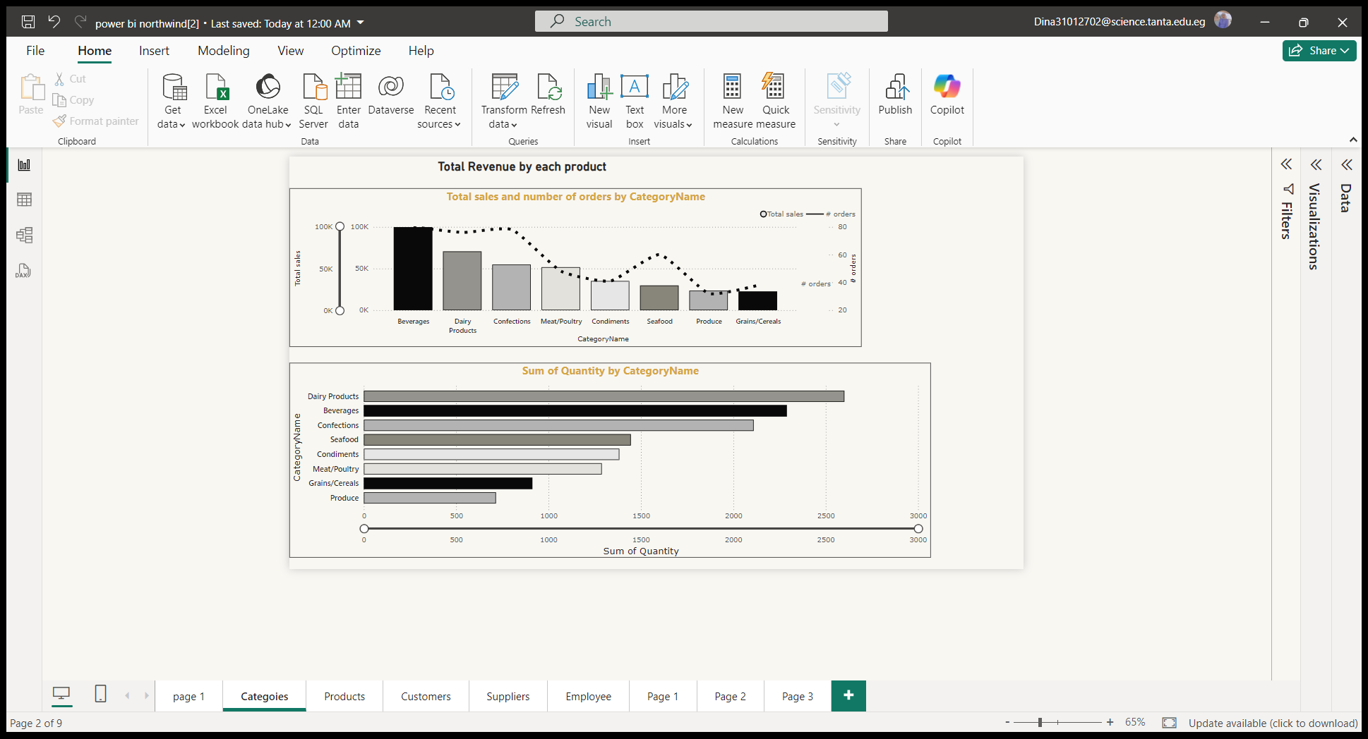

Slide 17
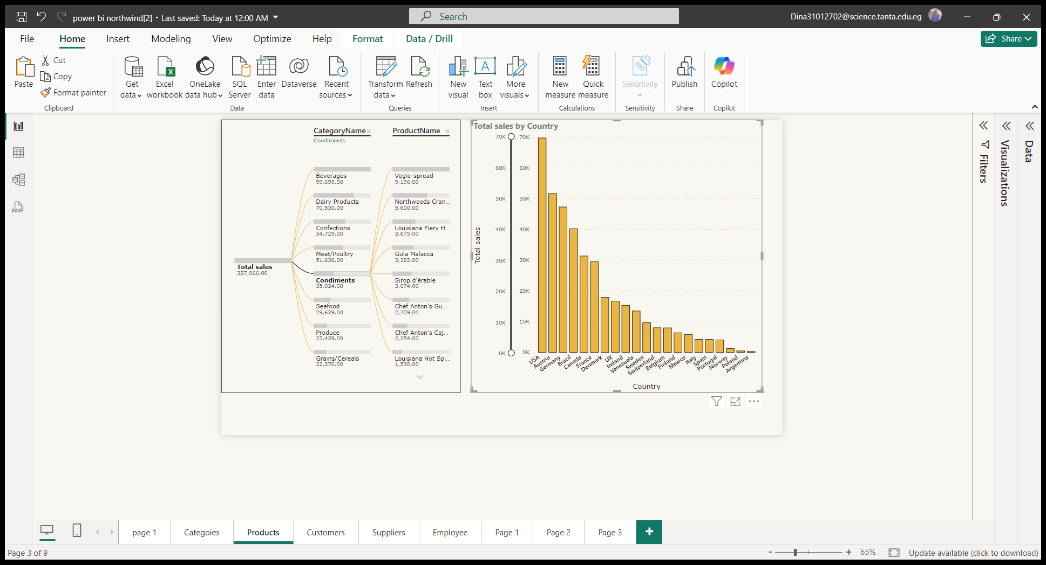

Slide 18
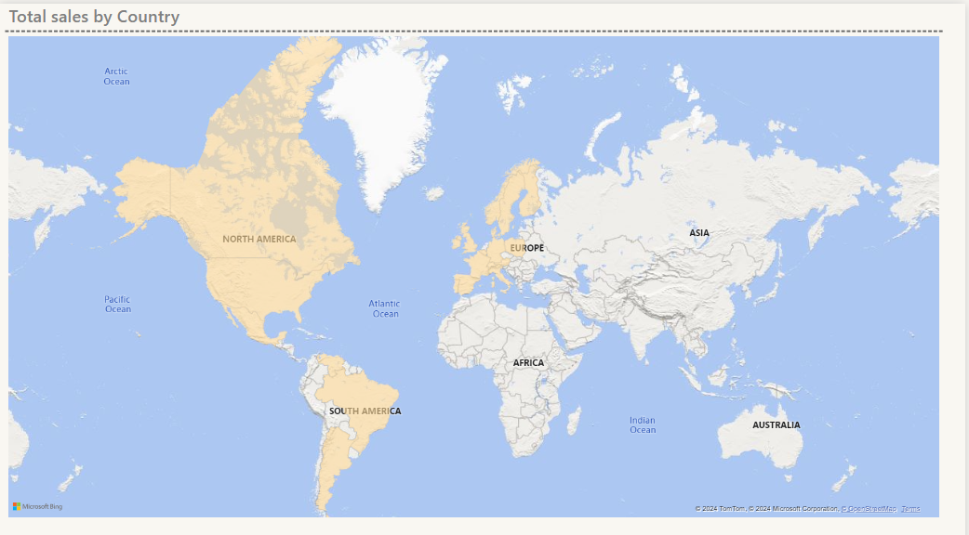

Slide 19
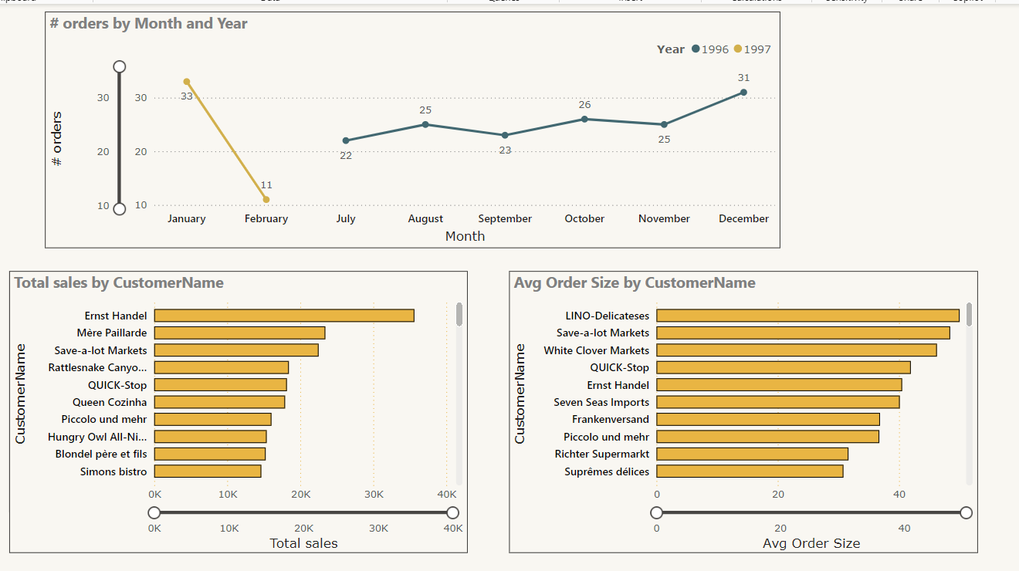

Slide 20
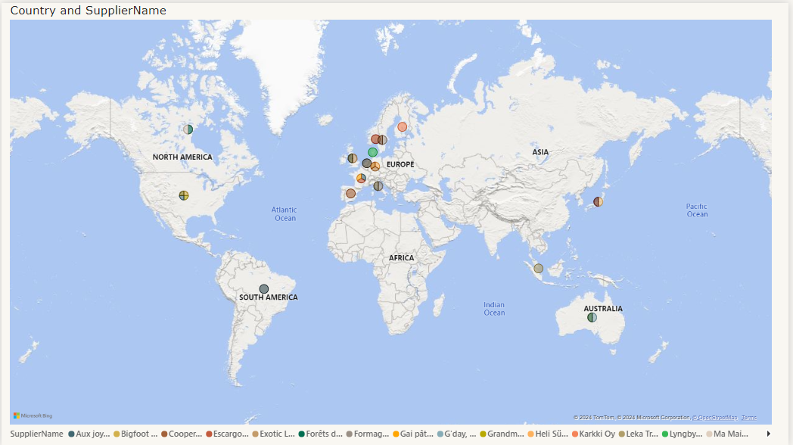

Slide 21
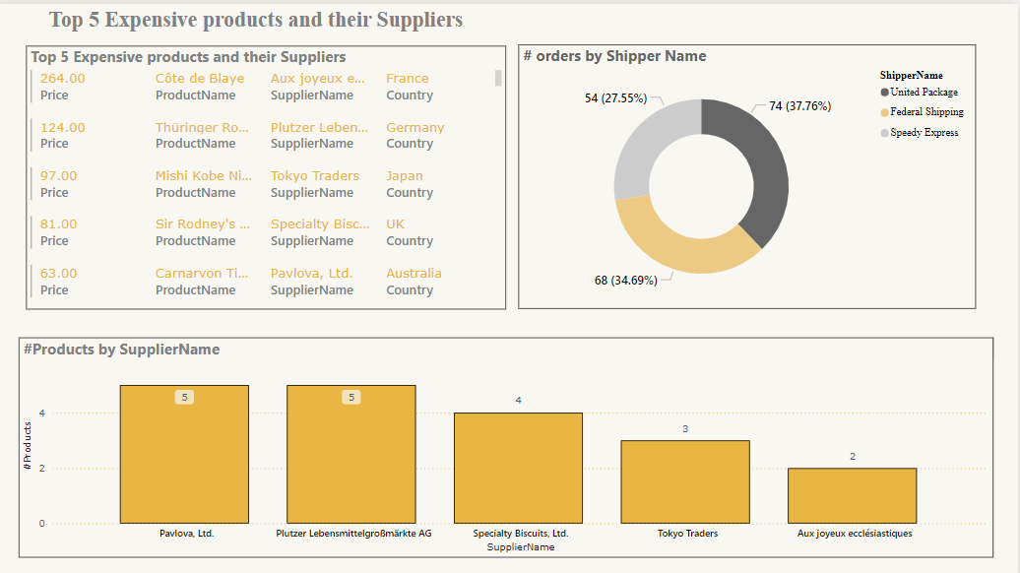

Slide 22
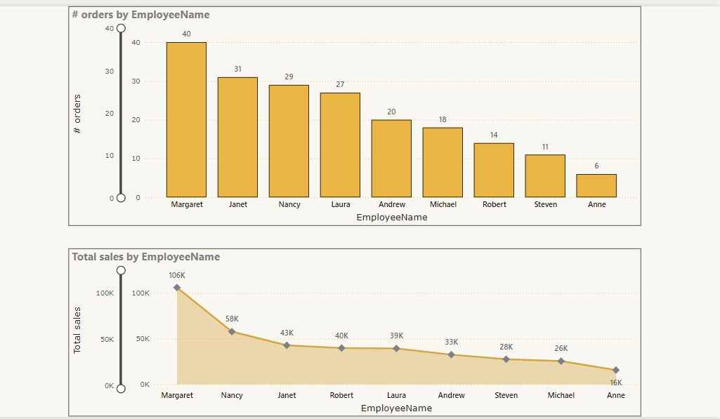

Slide 23
Recommendations
Process Efficiency: We might want to explore optimizing logistics or establishing more local suppliers in North America to reduce costs and improve supply chain efficiency.
Investigation: The company should thoroughly investigate the root cause of the issue during March last year then Jun the current year and ensure preventive measures are put in place to avoid future disruptions.(I suppose there a freeze due to float).
Customer Relations: Consider reaching out to customers affected during the downtime (March-June) to rebuild trust and ensure customer satisfaction wasn't significantly impacted.
Supplier Relations and Diversification: Strengthen relationships with top suppliers for better contracts. Explore opportunities to diversify suppliers, especially for critical or high-demand products, to ensure a stable supply chain and competitive pricing.
Employees Performance: Margaret: Recognize and reward her performance, and explore leadership opportunities such as mentoring other team members. Anne: Pair her with a mentor, offer skill development workshops, and establish a regular performance monitoring process. Other employees: Provide targeted sales training focused on closing techniques and conduct one-on-one reviews to identify challenges.
Organize team workshops to share best practices and regularly review performance metrics to guide training and improvement efforts.

Slide 24

Thank you very much!

